Slide 1
Chapter 11
Contours
Contour – a line that is drawn on a map to represent a line of constant elevation on the ground.
Contours on a map help the field engineer visualize the configuration of the ground.
The points are plotted and by connecting points of similar elevations contour lines are drawn.

Slide 2
Chapter 11
Contours
Connecting the points of similar elevation assures the contour intervals remain the same all the way around providing an accurate configuration of the ground.
Contours are useful for dealing with site work, landscaping and earthwork (excavation/embankment).

Slide 3
Chapter 11
Contours
The contours lines on maps are drawn in intervals.
Intervals may be drawn in ½ ft., 1 ft., 2 ft. or 5 ft. depending on the detail required.
The best contour interval depends on the degree of accuracy required, the slope of the ground, the scale of the map.

Slide 4
Chapter 11
Contours
Hill Contours are drawn free hand and wavy. The elevations increase from outside to inside and the contours close on each other.
Depressions are hills in reverse. The contours are also drawn free hand and wavy. The elevations decrease from outside to inside and the contours close on each other. To distinguish between hills, short perpendicular lines are drawn on the depression contour lines.

Slide 5
CHARACTERISTICS OF CONTOURS
A series of closed contour lines on the map represent a hill if the higher values are inside
80
75
70
65
HILL
60
60
65
70
75
80
A HILL

Slide 6
CHARACTERISTICS OF CONTOURS
80
vi) A series of closed contour lines on the map indicate a depression if the higher values are outside
75
DEPRESSION
70
65
60
70
60
65
70
75
80
A DEPRESSION

Slide 7
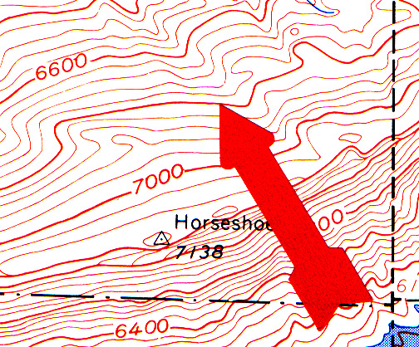
Chapter 11
Contours
Indexes – every fifth or tenth contour line is drawn boldly and marked with its elevation in order to determine the adjacent contour elevation.

Slide 8
Eleven (11) characteristics of contour lines
Contour lines are continuous.
Contour lines are relatively parallel unless one of two conditions exists.
A series of V-shape contours indicates a valley and the V’s point to a higher elevation.
A series U shape contours indicates a ridge. The U shapes will point to a lower elevation.
Evenly spaced lines indicate an area of uniform slope.

Slide 9
Contour Line Characteristics-cont.
A series of closed contours with increasing elevations indicates a hill and a series of closed contours with decreasing elevations indicates a depression.
Closed contours may be identified with a +, hill, or -, depression.
Closed contours may include hachure marks. Hachures are short lines perpendicular to the contour line. They point to a lower elevation.

Slide 10
Contour Line Characteristics-cont.
The distance between contour lines indicates the steepness of the slope. The greater the distance between two contours the less the slope. The opposite is also true.
Contours are perpendicular to the maximum slope.
A different type of line should be used for contours of major elevations. For example at 100, 50 and 10 foot intervals. Common practice is to identify the major elevations lines, or every fifth line, with a bolder, wider, line (index).

Slide 11
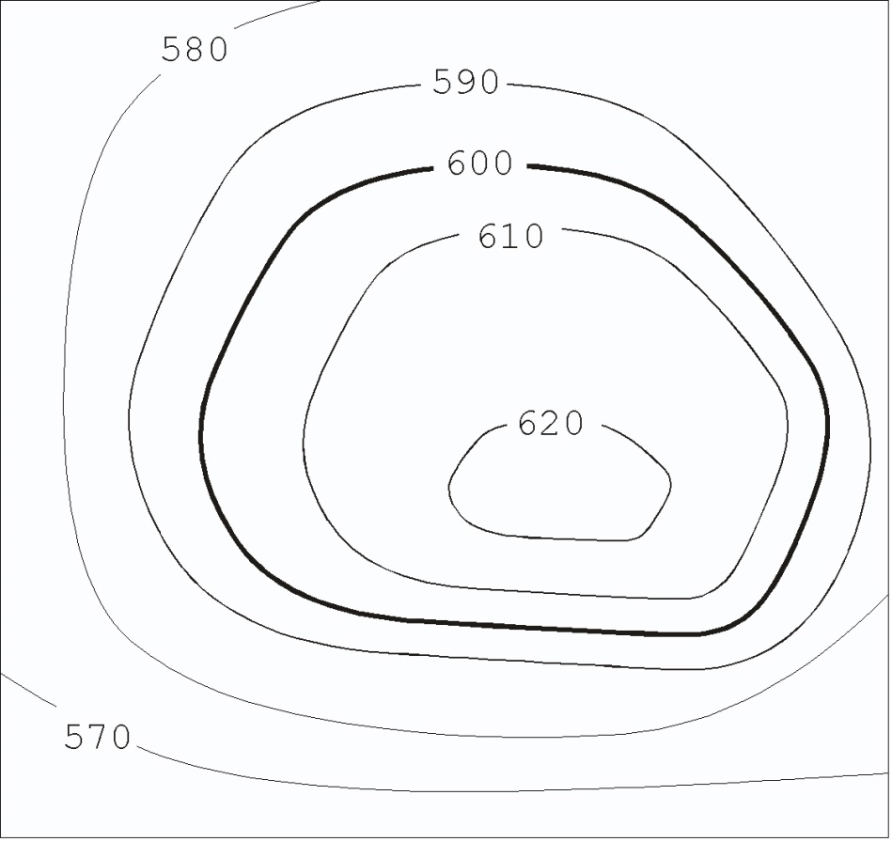
1. Contours are Continuous
Some contour lines may close within the map, but others will not.
In this case, they will start at a boundary line and end at a boundary line.
Contours must either close or extend from boundary to boundary.

Slide 12
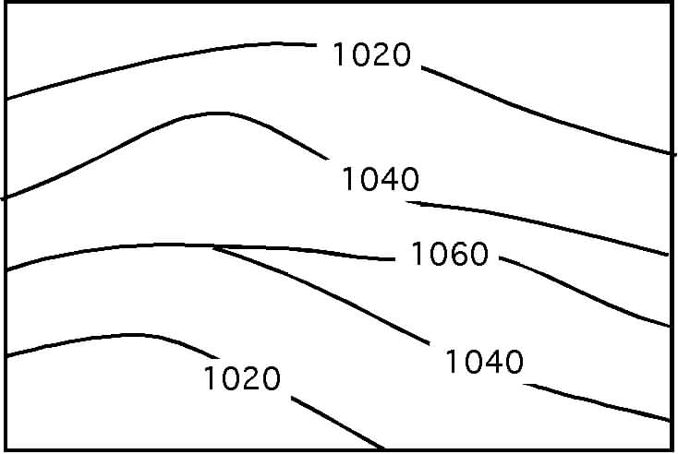
1. Continuous Contours-cont.
Is the topo map correct?
No
Contour 1040 is very unlikely
This would only occur if there were a long vertical wall.

Slide 13
CHARACTERISTICS OF CONTOURS
x) Contour lines never run into one another except in the case of a vertical cliff. In this case ,several contours coincide and the horizontal equivalent becomes zero.
50
40
VERTICAL
CLIFF
30
20
10
10
50
20
30
40
50
VERTICAL CLIFF

Slide 14
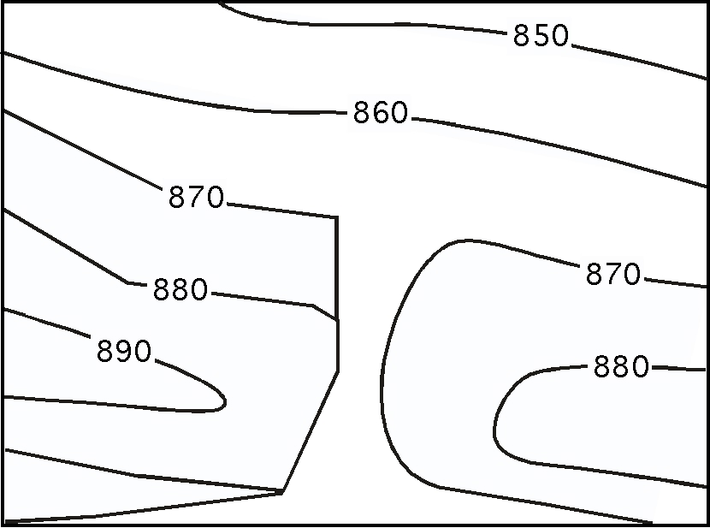
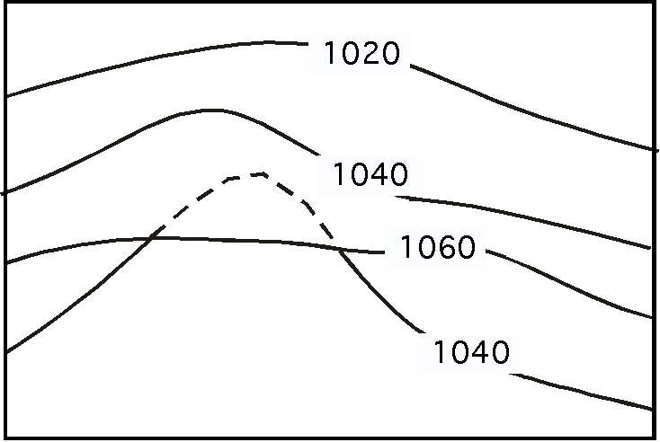
2. Contour lines are parallel
Two exceptions:
  They will meet at a vertical cliff
  They will overlap at a cave or overhang.
  3. When contour lines overlap, the lower elevation contour should be dashed for the duration of the overlap.

Slide 15
CHARACTERISTICS OF CONTOURS
ix).
Contour lines cannot merge or cross one another on map except in the case of an overhanging cliff.
40
30
20
10
40
30
20
10
OVERHANGING CLIFF

Slide 16
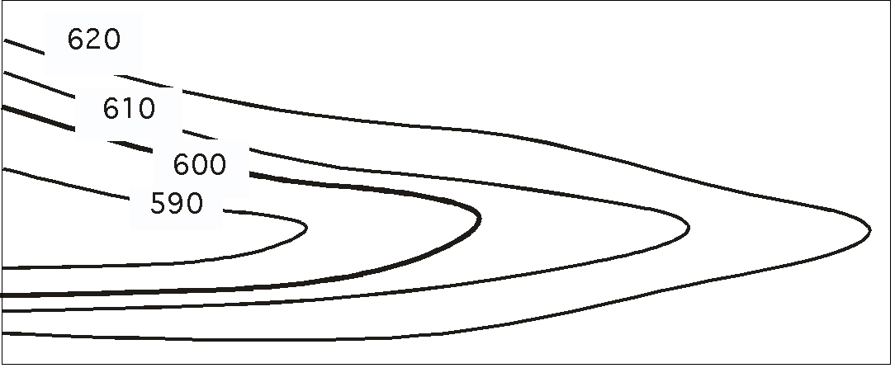
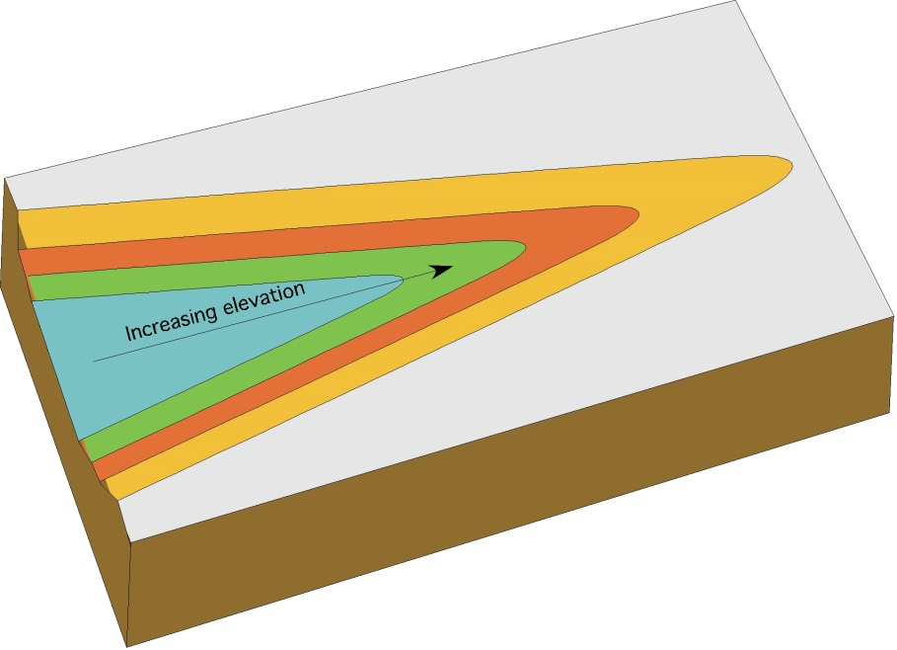
3. Valleys and higher elevation
A series of V-shapes indicates a valley and the V’s point to a higher elevation.

Slide 17
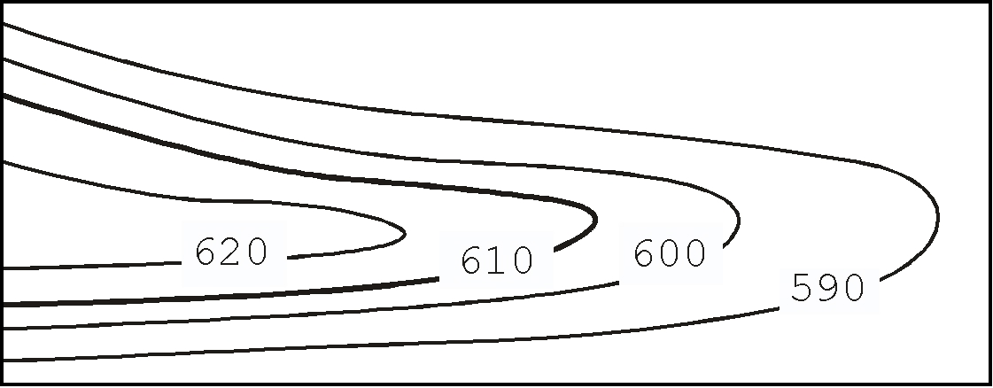
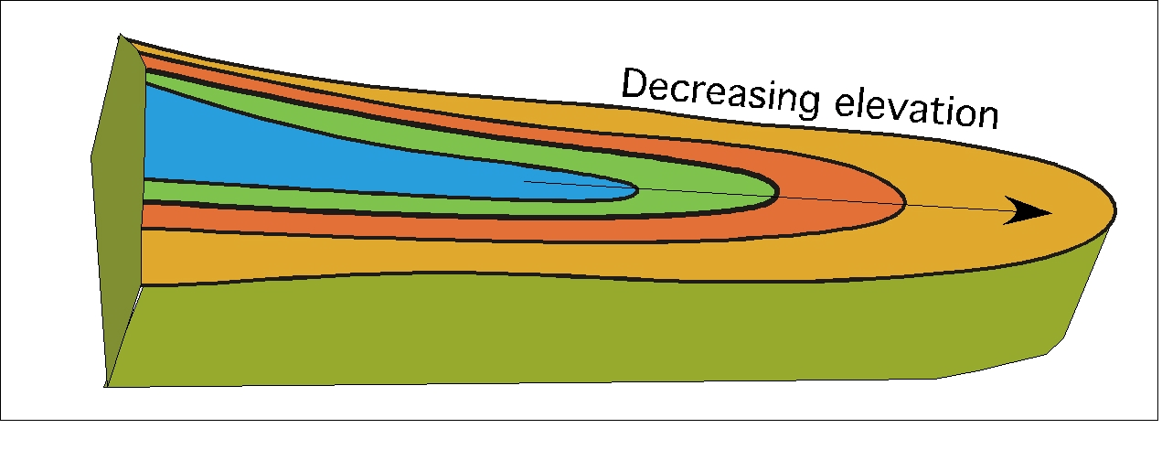
4. U shapes and ridge
A series of U shapes indicates a ridge. The U shapes will point to lower a elevation.

Slide 18
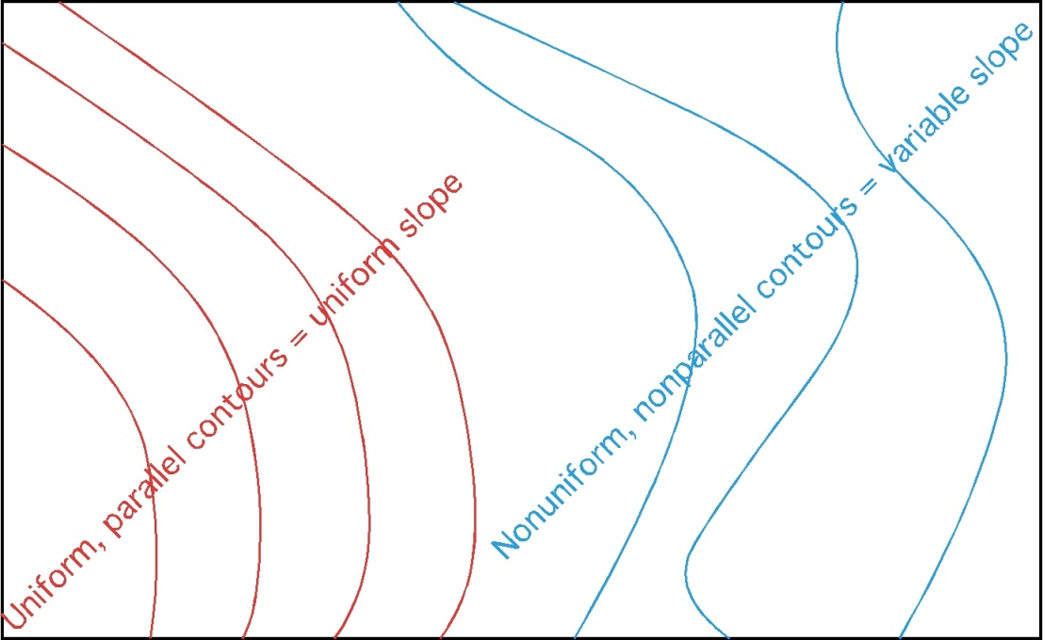
5. Contour Spacing
Evenly spaced contours indicate an area of uniform slope.
Unevenly spaced contours indicates an area with variable slope.

Slide 19
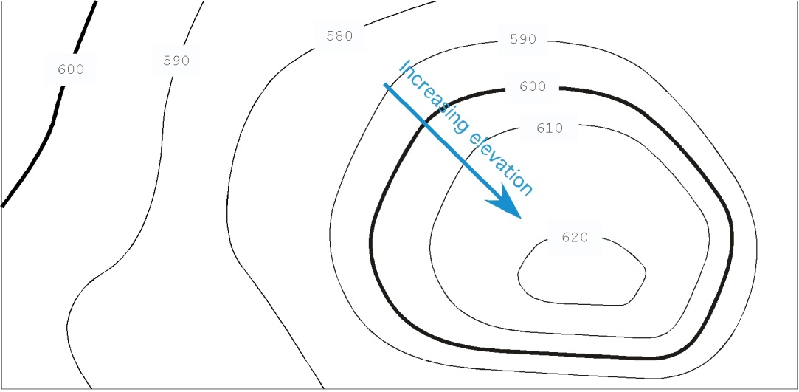
6. Hills and Depressions
A series of closed contours with increasing elevation indicates a hill.
Hills may be identified with a “+” with the elevations

Slide 20
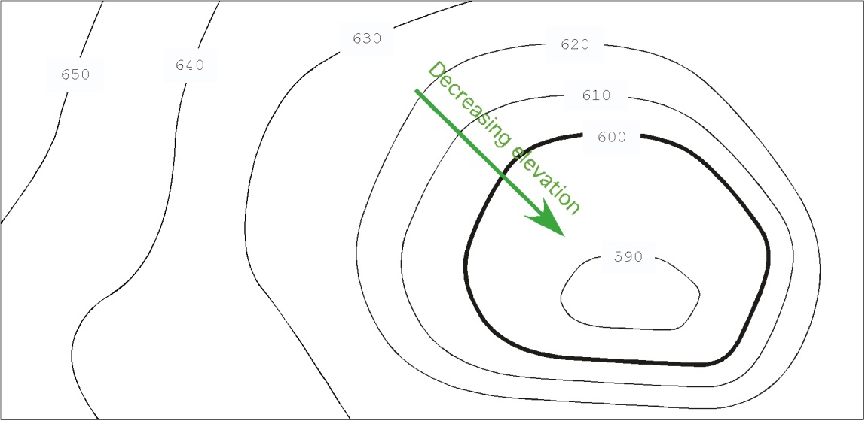
6. Hills and Depressions--cont.
A series of closed contours with decreasing elevation indicates a depression.
Depressions may be identified with a “ - ”.

Slide 21
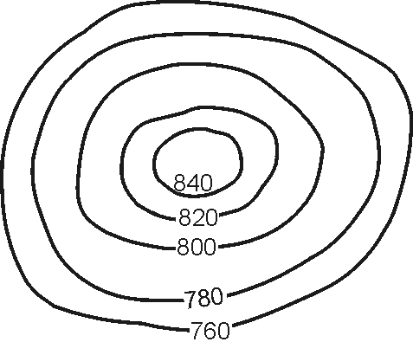
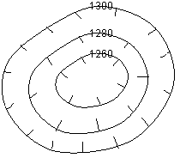
7. Hills & Depressions
Hill Contours
Depression Contours

Slide 22
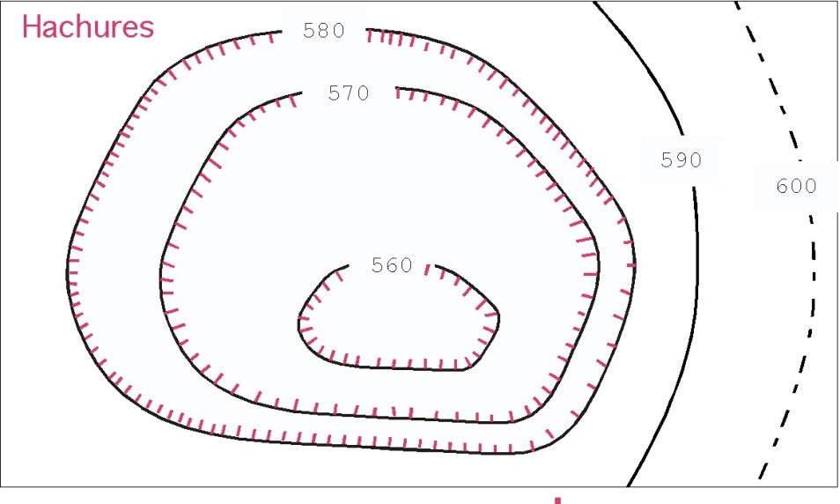
8. Hachures
Hachures are short lines which are perpendicular to the contour line.
Used to indicate a hill or a depression.
Not used on modern maps.

Slide 23
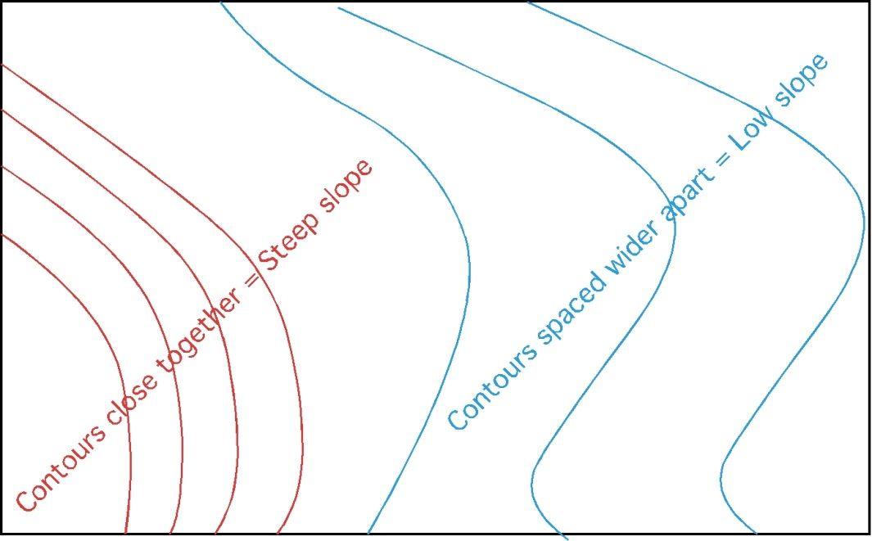
9. Contour Spacing
Contours spaced close together indicate a higher % slope.
Contours spaced wider apart indicate lower % slope.

Slide 24
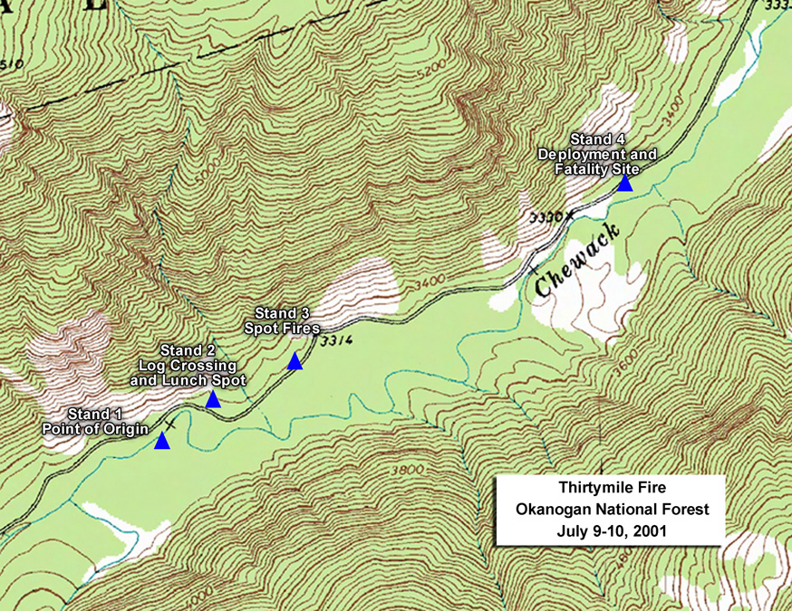
9. Contour Spacing--cont.
Contours are perpendicular to maximum slope.
Different types of lines should be used for contours of major elevations.
Common practice is to identify the major elevations lines, or every fifth line, with a bolder, wider, line.

Slide 25
9. Contour Spacing-Intervals
Another decision that must be made is the contour interval.
The “best” interval depends on the use of the data.

Slide 26
Contour Intervals--cont.
Types of topo map | Nature of terrain | Recommended interval (feet)
Large Scale | Flat | 0.5 or 1
 | Rolling | 1 or 2
 | Hilly | 2 or 5
Intermediate scale | Flat | 1, 2 or 5
 | Rolling | 2 or 5
 | Hilly | 5 or 10
Small scale | Flat | 2, 5 or 10
 | Rolling | 10 or 20
 | Hilly | 20 or 50
 | Mountainous | 50, 100 or 200

Slide 27
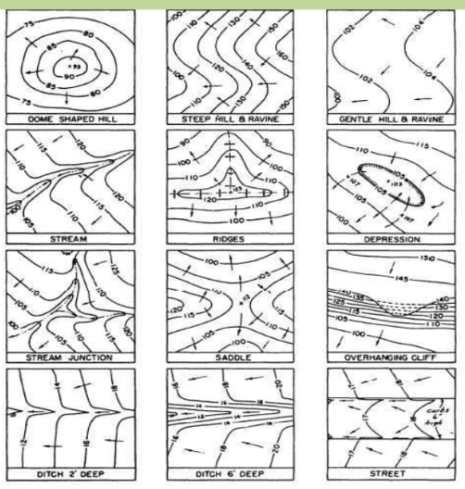
Characteristics of Contours

Slide 28
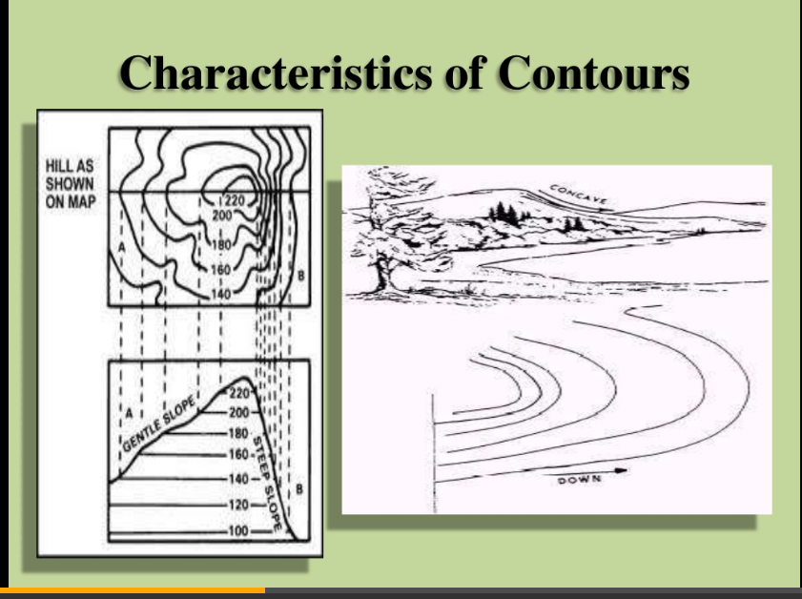
Characteristics of Contours

Slide 29
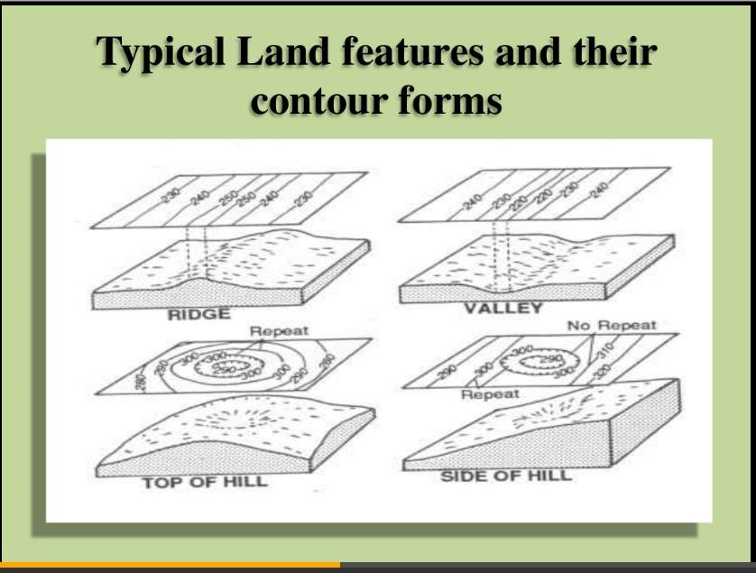
Typical Land Features and Their Contour Forms

Slide 30
Interpolation

Slide 31
Interpolation
Drawing contour lines to produce a topographic map requires the ability to interpolated between points.
Interpolation is required because contour lines are lines of constant elevation and the station elevations that are measured in the field seldom fall on the desired contour elevation.
Interpolating is finding the proportional distance from the grid points to the contour line elevation.

Slide 32
Interpolation
Interpolating can be done by estimation for low precision maps.
It should be done by calculation and measurement for higher precision maps.
A combination of methods can also be used, depending on the use of the map.

Slide 33
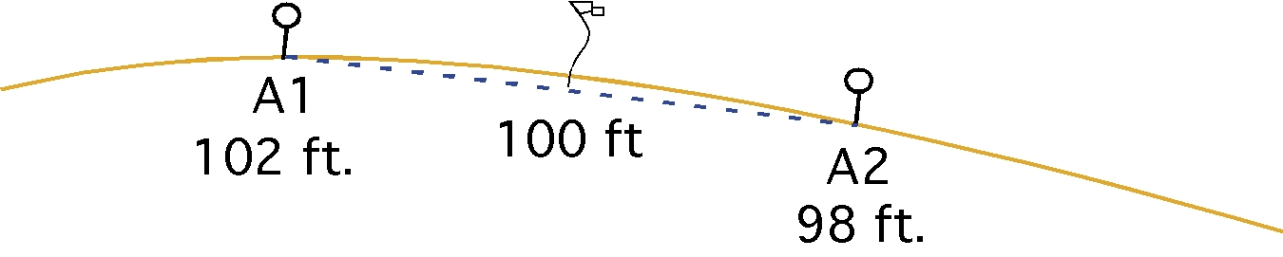
Interpolating by Estimation
Study the illustration.
Logic or intuitive reasoning would conclude that when the grid points are at 102 feet elevation and 98 feet elevation, then a contour line of 100 feet elevation would be half way in between.
Note: that a dashed line has been drawn between the two points. In topographic surveying it is assumed that the area between two measured stations is a plane.

Slide 34

Interpolating by Calculation
Proportional distance is calculated using an equation.
For the previous example this would result in:
The 100 foot contour line would be located 0.5 or half of the distance between the two stations.

Slide 35
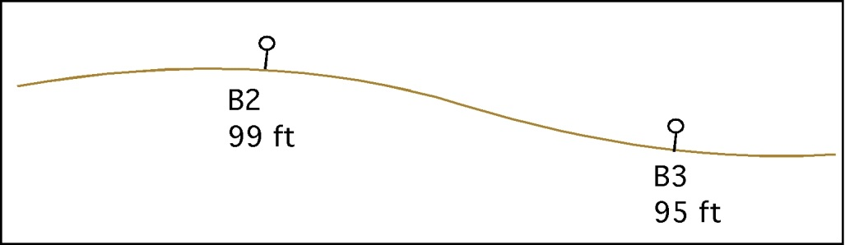
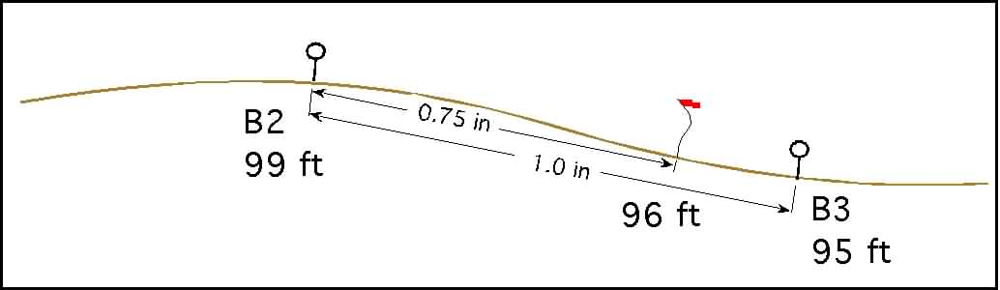
Interpolation by Calculation & Estimation
The same equation is used for all grid distances and all contour lines.
Example: Determine the location of the 96 foot contour line for the illustration.

Slide 36
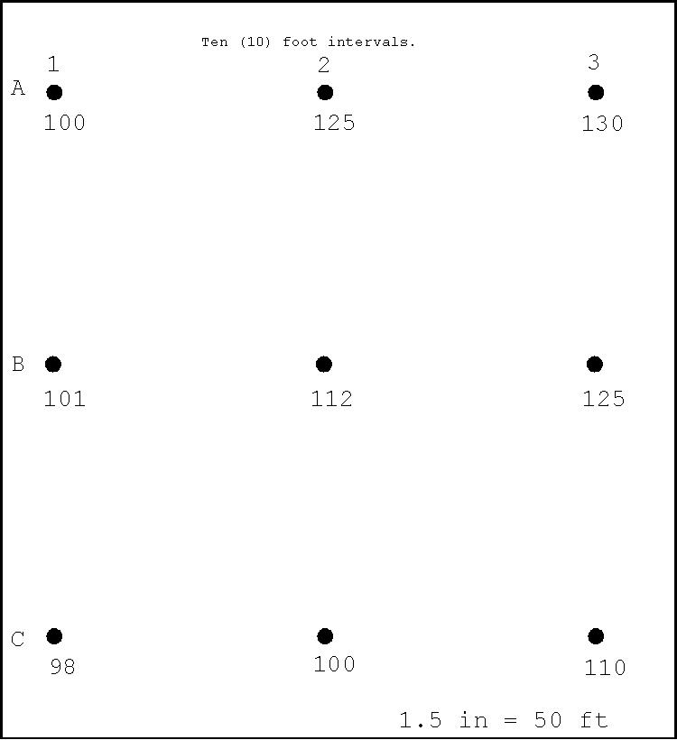
Interpolation by Calculation and Measurement
Start by selecting a contour interval and two grid points.
This example starts with the 110 foot interval.
The first step is to calculate the position of the 110 foot contour between stations A1 and A2.

Slide 37
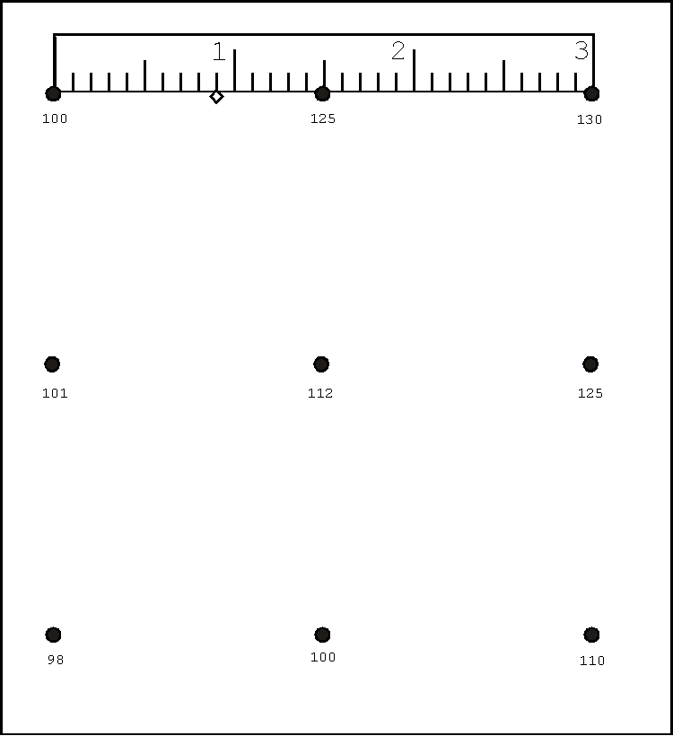
Interpolation by Calculation and measurement--cont.
The next step is to measure and mark the position of 0.6.
Next, determine which direction the contour goes between the diagonal and the other three sides of the grid.
Mark the next points.

Slide 38
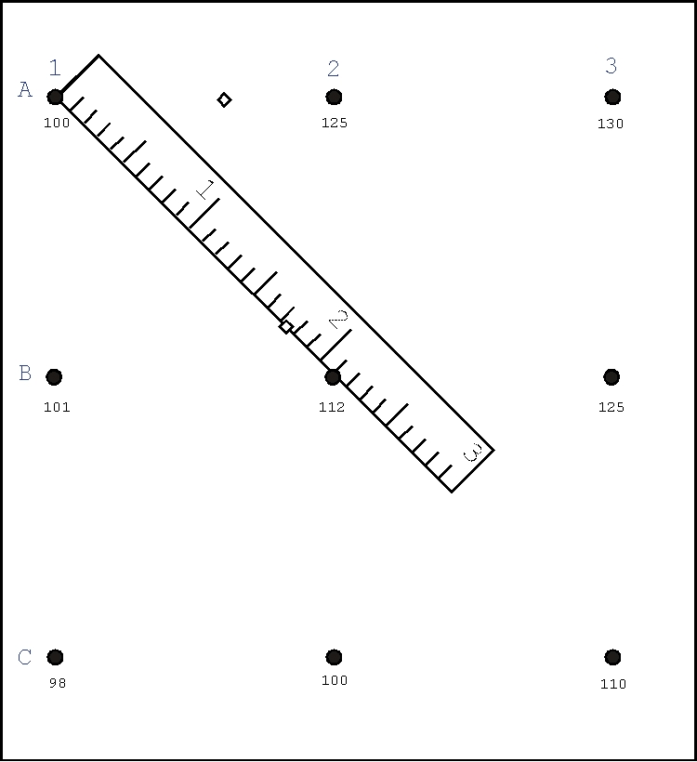
Interpolation by Calculation and measurement--cont.
The 110 foot contour line passes between B1 and B2, therefore the next station is the diagonal.
These steps are followed one grid line at a time until the contour closes, or reaches the edge of the map.

Slide 39
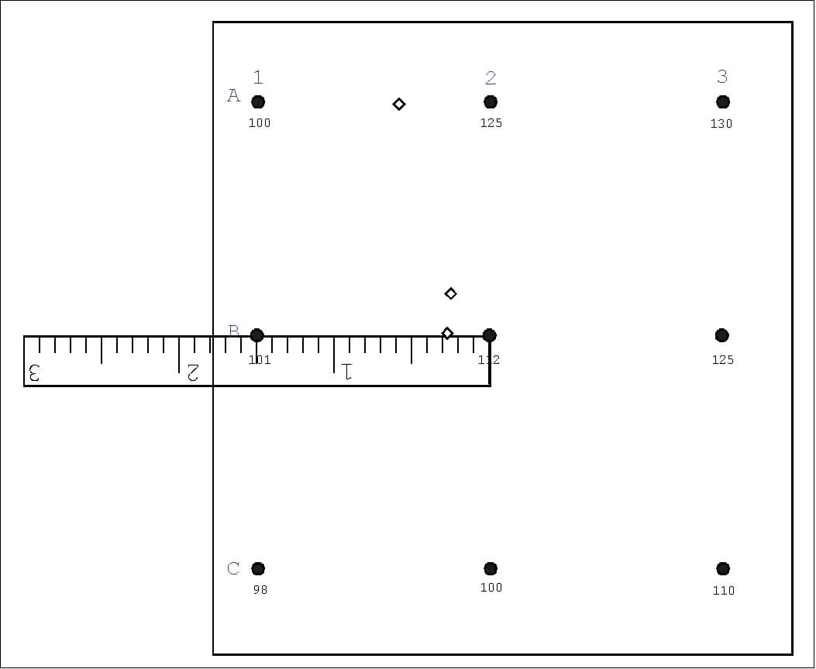
Interpolation by Calculation and measurement--cont.
Determining the proportion for line B1:B2.

Slide 40
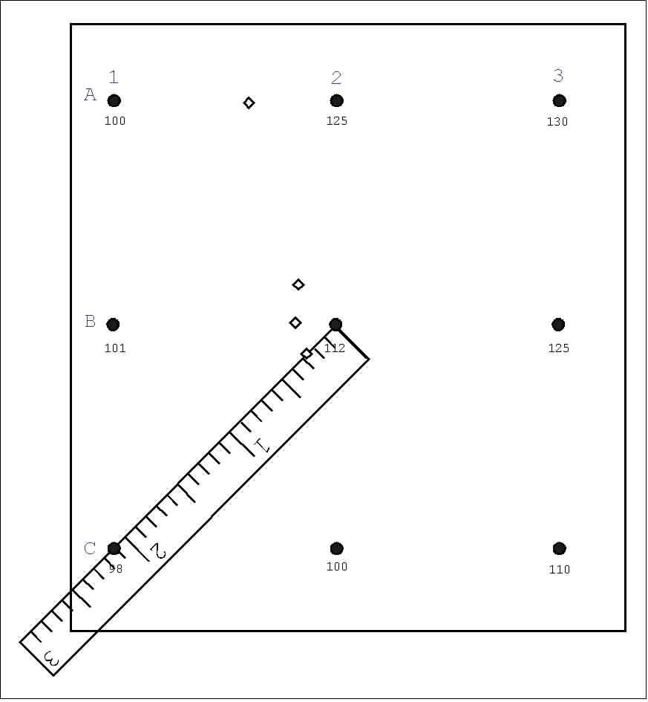
Interpolation by Calculation and measurement--cont.
The grid lines and diagonals for each square are considered and the contour is extended.

Slide 41
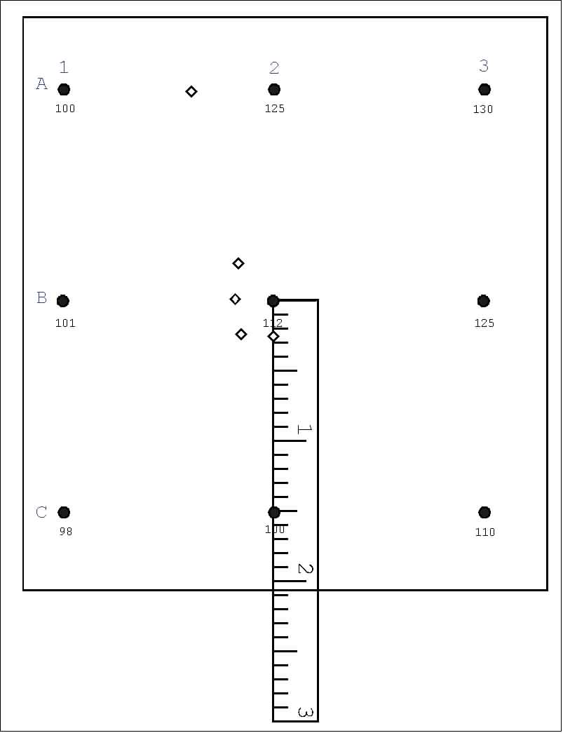
Interpolation by Calculation and measurement--cont.
The next grid line is between B2 and C2.

Slide 42
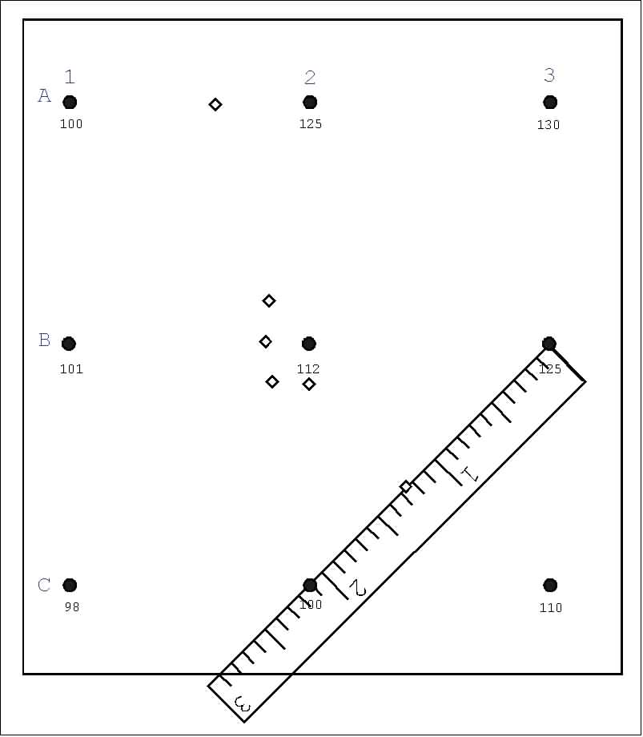
Interpolation by Calculation and measurement--cont.
Each grid line and diagonal is considered and the contour line is extend between the appropriate points.

Slide 43
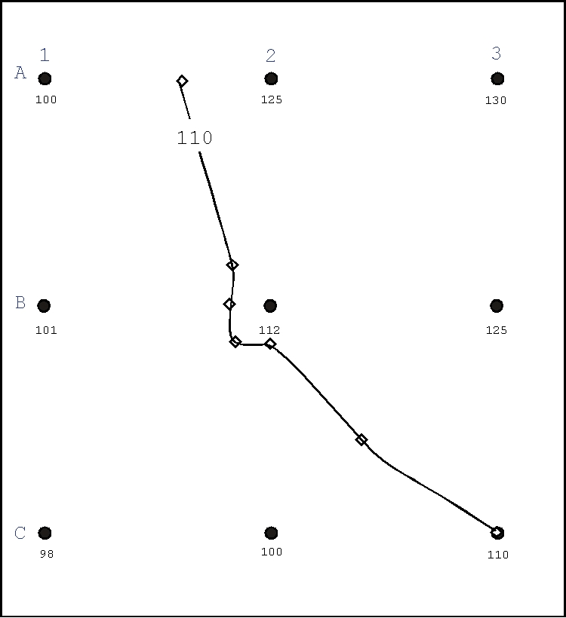
Interpolation by Calculation and measurement--cont.
When the contour points form a closed shape or have extended from one edge of the map to another, a smooth line is drawn connecting the points.
The contour lines must be labeled.

Slide 44
Drawing Contour Lines
Topographic maps are three dimensional.
When drawing contour lines all possible paths must be investigated.
A simple grid will be used to demonstrate this point.

Slide 45
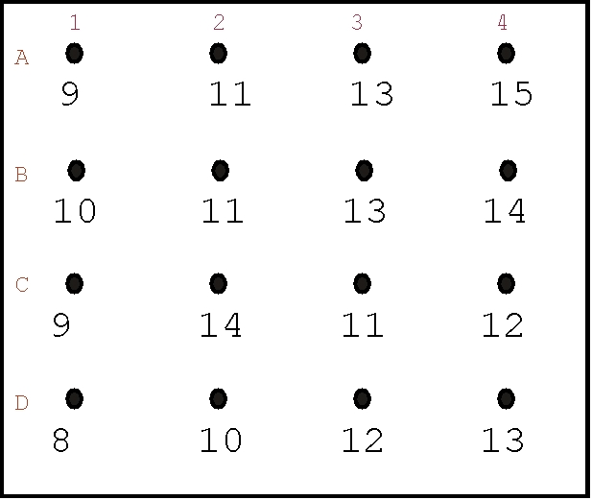
Drawing Contour Lines-cont.
In this example even numbered contours will be used.
There is no right or wrong starting point.
Pick a contour interval, start at one edge and extend the contour across the map.
This example starts with the 14 foot contour.

Slide 46
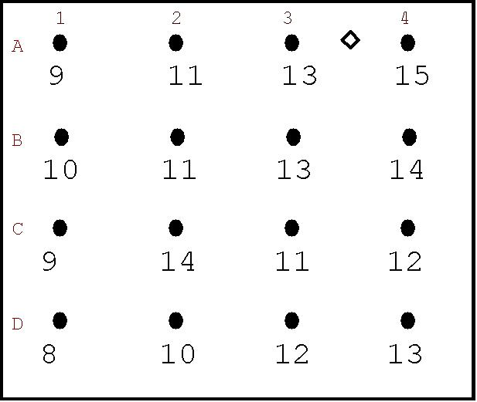
Grid Example--cont.
A3 is at 13 ft. elevation and A4 is at 15 ft. elevation, a 14 ft. contour would be half way in between.
The next step is to determine which diagonal and which grid line it passes through.
A3 and B3 are both at 13 ft., therefore the 14 foot contour does not pass between them.
B4 is at 14 ft., therefore the 14 ft. contour interval would pass through station B4.
Before marking station B4 the diagonals must be checked.

Slide 47
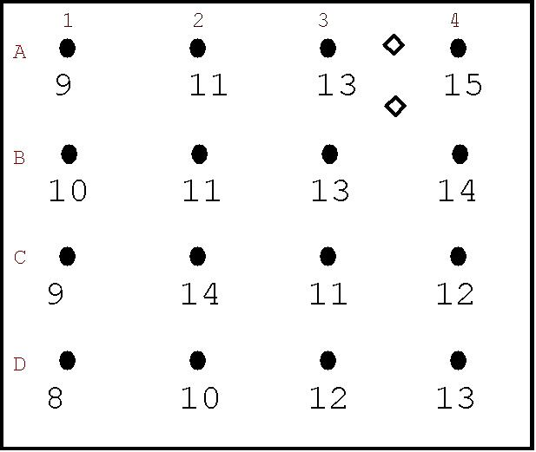
Grid Example--cont.
The diagonals must be checked to determine if the 14 ft. contour continues to station B4.
B3 is at 13 ft., A4 is at 15 ft., a 14 ft. elevation is present between these two points, therefore the contour line can be extended to station B4.
Each pair of grid points are investigated and the contour is extended until it is complete.

Slide 48

Grid Example--cont.
To extend the contour the next options must be checked.
Station B3 is at 13 feet elevation and station B4 is at 14 feet elevation.
The contour extends from the diagonal position to station B4.

Slide 49
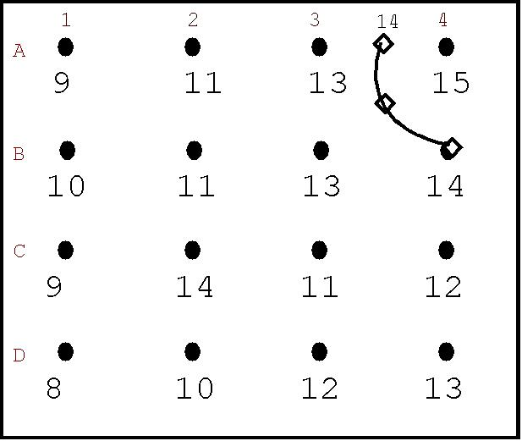
Grid Example--Drawing Contour Lines
This contour is completed by connecting the points with a smooth line.

Slide 50
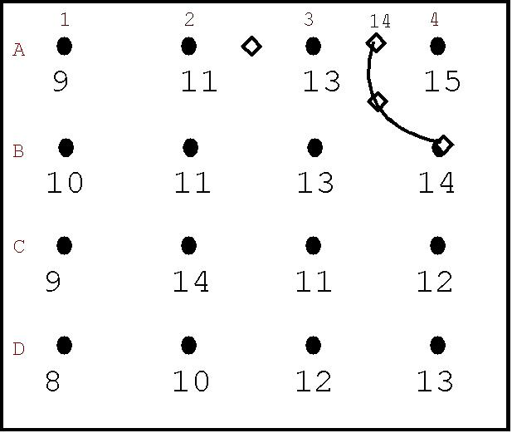
Grid Example--cont.
The 12 foot interval is completed in the same way.
A2 is at 11 ft. and A3 is at 13 ft., therefore the 12 foot contour is half way between A2 and A3.
A2 and B2 are both at 11 ft., the contour doesn’t go between these two.
A3 is 13 ft. and B3 is 13 ft., it doesn’t go this way.
B2 is 11 ft. and B3 is 13 ft., a 12 ft. elevation is half way between. This 12 ft. interval will pass through this point, as long as the diagonals are ok.

Slide 51
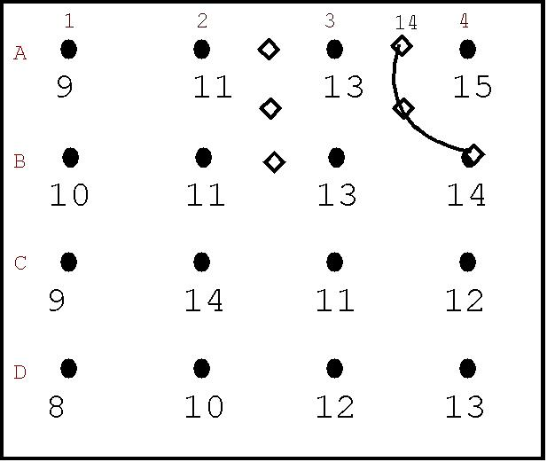
Grid Example-cont.
The next grid is more difficult because a 12 foot contour line will pass through both B2:C2 and B3:C3.
In addition to go either way would violate the diagonals.
The remaining points must be investigated to determine the best path.

Slide 52
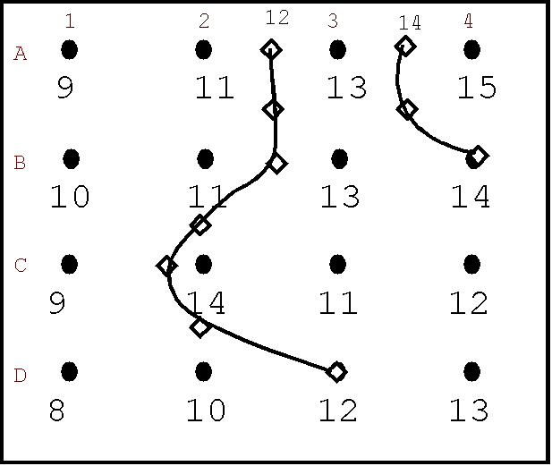
Grid Example--cont.
If the contour is extended through B2:C2 and completed to D3, the diagonal must also be violated at D2:C3 to continue on to D3.
There should be a better interpretation.

Slide 53
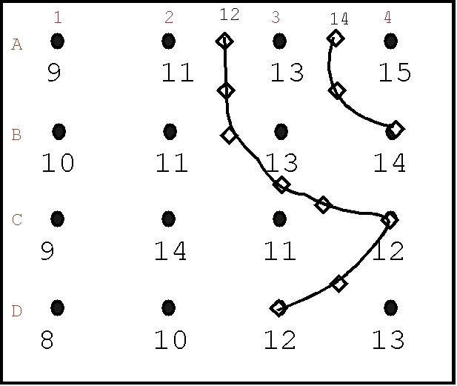
Grid Example--cont.
The contour should be completed by passing between B3:C3.
This a better interpretation because:
  The contour is completed without violating the diagonal at C3:D4.
  The 12 foot contour parallels the 14 foot contour.

Slide 54
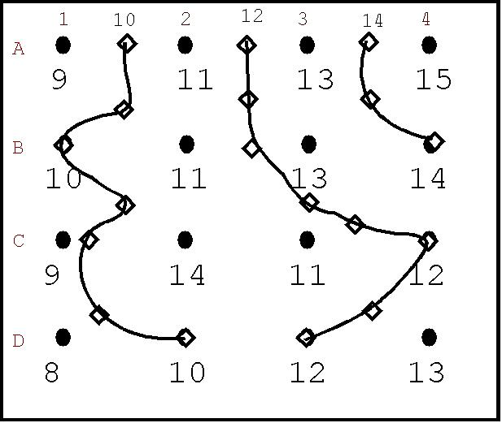
Grid Example--cont.
The 10 foot interval is completed in the same way.
At this point there is a danger of considering the map complete, but you must always check for a possible hill or depression on the map.
In this example there is 12 foot contour around C2.

Slide 55
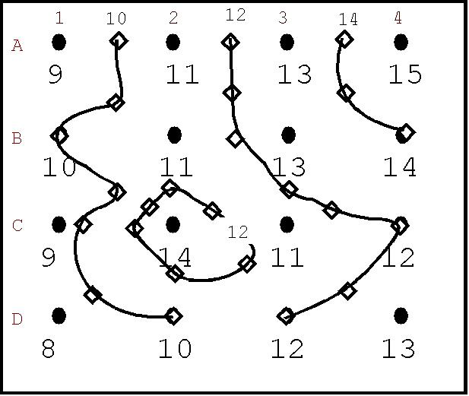
Grid Example--cont.
Putting in the 12 foot contour around C2 violates the diagonal between C2 and B3.
This is acceptable because it should be clear that a valley exists from A2 through B2 through C3 and then to at least C2.

Slide 56
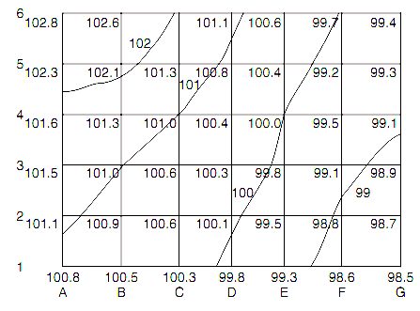
Contours at 1 ft. Intervals

Slide 57
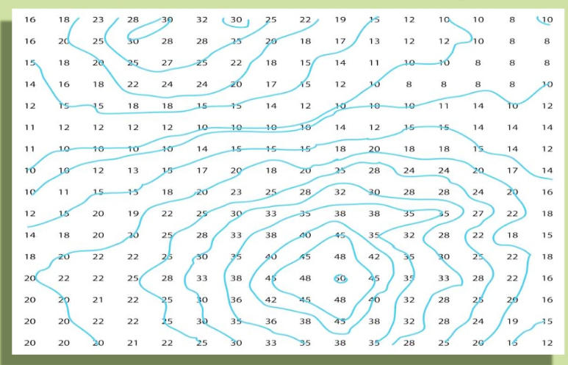
Contours at 5 ft. Intervals

